Slide 1

QSM Training
Javascript
May 6, 2019

Slide 2
Things To Cover
JavaScript Fundamentals
Data types
Operators And Comparisons
Array Methods
Promises
Resources

Slide 3
Data types
Number: for both floating-point and integer numbers.
String: for strings.
Boolean: for logical values: true/false.
Null: a type with a single value null, meaning “empty” or “does not exist”.
Undefined: a type with a single value undefined, meaning “not assigned”.
Object and symbol: for complex data structures and unique identifiers.

Slide 4
Operators And Comparisons
Unary: operation on single argument
Binary: operation on multiple argument
String concatenation
Number concatenation
String comparison
Comparison of different types
Strict equality (===)
Notes:
Unary plus - same thing as Number(...), but is shorter
Binary plus - if either operand is a string, the other one is converted into a string as well
String comparison - strings are compared letter-by-letter.
Comparison of different types - JavaScript converts the values to numbers.
Strict equality operator (===) - checks the equality without type conversion

Slide 5
Operators And Comparisons
Comparison operators return a Boolean value.
Strings are compared letter-by-letter in the “dictionary” order.
When values of different types are compared, they get converted to numbers (with the exclusion of a strict equality check).
The values null and undefined equal == each other and do not equal any other value.
Be careful when using comparisons like > or < with variables that can occasionally be null/undefined. Checking for null/undefined separately is a good idea.

Slide 6
Array Methods
Add/remove items (Mutable):
arr.push(...items) – adds items to the end,
arr.pop() – extracts an item from the end,
arr.shift() – extracts an item from the beginning,
arr.unshift(...items) – adds items to the beginning.
Splice (Mutable): insert, remove and replace elements.
Slice (Immutable): arr.slice(start, end)
Concat (Immutable): arr.concat(arg1, arg2...)
Split : str.split(delimiter)
Join: arr.join(separator)
Notes:
push(...items) – adds items to the end,
pop() – extracts an item from the end,
shift() – extracts an item from the beginning,
unshift(...items) – adds items to the beginning.
splice(pos, deleteCount, ...items): Is a swiss army knife for arrays. It can do everything: insert, remove and replace elements.
slice(start, end) : It returns a new array containing all items from index "start" to "end" (not including "end"). Both startand end can be negative, in that case position from array end is assumed.
concat(...items): The method arr.concat joins the array with other arrays and/or items.
It accepts any number of arguments – either arrays or values.
The result is a new array containing items from arr, then arg1, arg2 etc.
Split:
The str.split(delim) method does exactly that. It splits the string into an array by the given delimiter
Join:
The call arr.join(separator) does the reverse to split. It creates a string of arr items glued by separatorbetween them.

Slide 7
Array Methods
Iterate
arr.forEach( function(item, index, array){… })
arr.map( function(item, index, array){… })
arr.filter( function(item, index, array){… })
Arr.reduce( function( previousValue, item, index, array){… }, initialValue)
Search:
arr.indexOf(item, from)
arr.includes(item, from)
arr.find( function(item, index, array){… })
Sort (Mutable)
isArray: Array.isArray(value)
Notes:
forEach:
The arr.forEach method allows to run a function for every element of the array - does not return anything.
Map:
The arr.map method calls the function for each element of the array and returns a new array of results.
Filter:
The syntax is similar to find, but filter continues to iterate for all array elements even if true is already returned:
Reduce:
The methods arr.reduce is used to calculate a single value based on the array.
indexOf and includes
arr.indexOf(item, from) looks for item starting from index from, and returns the index where it was found, otherwise -1.
arr.includes(item, from) – looks for item starting from index from, returns true if found.
Find:
If it returns true, the search is stopped, the item is returned. If nothing found, undefined is returned.
Sort:
The method arr.sort sorts the array in place.
The items are sorted as strings by default.
iaArray:
Array.isArray(value). It returns true if the value is an array, and false otherwise

Slide 8
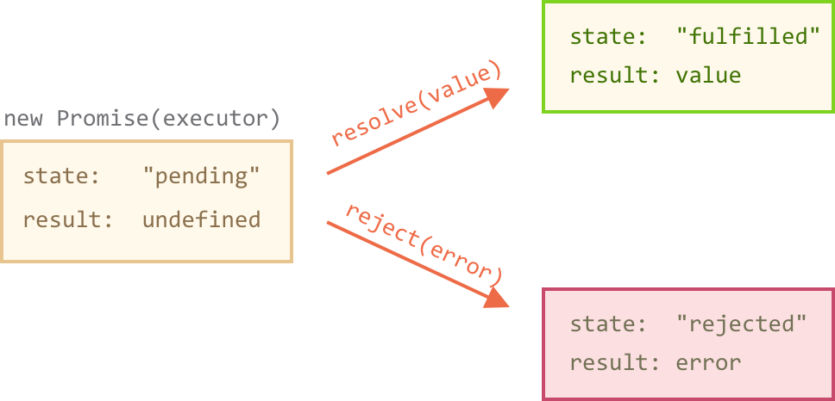
Promises

Slide 9
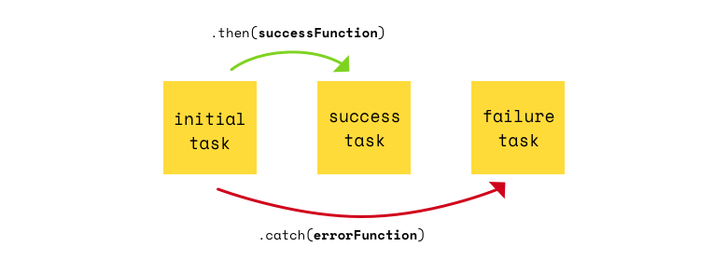
Promises
Consumers:
Then: .then(successFunction, errorFunction).
Catch: .catch(errorHandlingFunction)
Finally: .finally(finallyFunction)
Notes:
Then():
The .then()method accepts two optional parameters. First, a function called if the promise is fulfilled. Second, a function called if the promise is rejected.
Catch:
The call .catch(f) is a complete analog of .then(null, f), it’s just a shorthand.
Finally:
Just like there’s a finally clause in a regular try {...} catch {...}, there’s finally in promises.
finally is a good handler for performing cleanup
A finally handler has no arguments
Finally passes through results and errors to the next handler

Slide 10
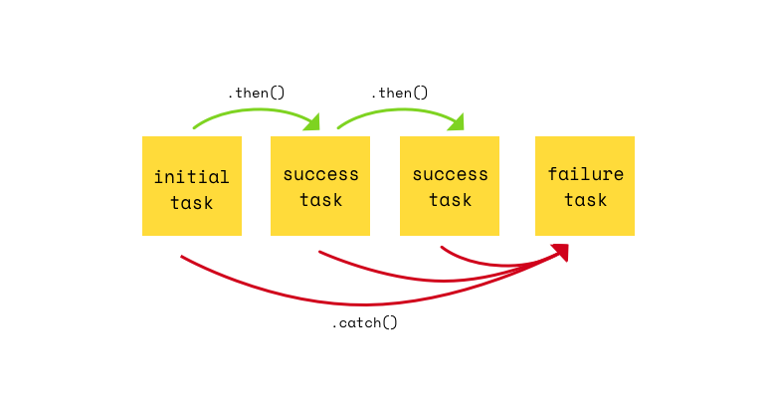
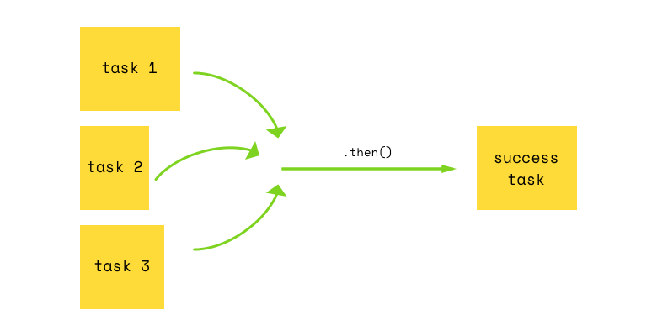
Promises
Channing: .then( success, fail) .then( success, fail)
Promises in Parallel: Promise.all( ArrayOfPromises)

Slide 11
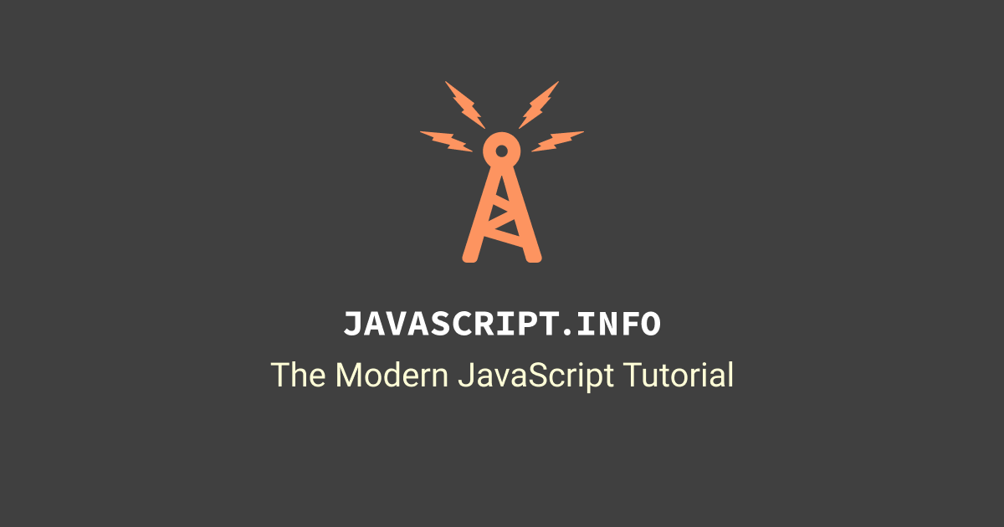

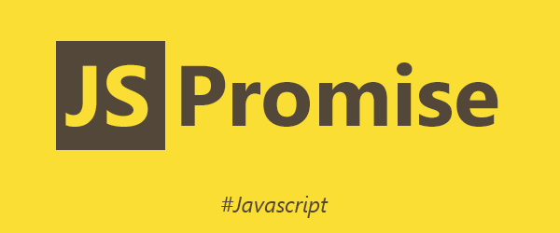
Resources
Notes:
https://javascript.info/
https://bitsofco.de/javascript-promises-101/
http://es6-features.org

